Slide 1
DBMS Final Project: ArtifactStore
A Typed and Permission-Scoped Tool-Result Store for AI Agent Harnesses
第三組
陳浩文B11902156
白謹瑜 F10543030
何吉峻 R14921126

Slide 2
Outline

Slide 3
Motivation: Tool Outputs Overload Agent Context
User
Run the pytest workload on target and …
========================== test session starts ======================
platform darwin -- Python 3.11.7, pytest-8.2.0, pluggy-1.5.0
rootdir: /Users/dev/example-app
collected 47 items
tests/test_login.py .......... [ 21%]
tests/test_refresh.py ........ [ 38%]
tests/test_auth.py .....F..... [ 61%]
tests/test_session.py ............ [ 87%]
tests/test_oauth.py ...... [100%]
========================== FAILURES =============================
_______________________ test_auth_expiry __________________________
self = <tests.test_auth.TestAuthExpiry object at 0x10e1c2d50>
def test_auth_expiry(self):
token = mint_token(user_id=42, ttl_seconds=3600)
# advance the clock by 30 minutes; token should still be valid
with freeze_time(datetime.now() + timedelta(minutes=30)):
> assert validate_token(token) is True, "token expired prematurely"
…… more
LLM
Tool Call
Pytest
Tool Call Results contains large logs
It occupy and squeeze the context window
Therefore, tool call results should not be directly appended to the context window
Ex: Total token=9,609

Slide 4
Existing Ways to Handle Large Tool Outputs
Approach | Description | failure mode
Raw accumulation | Keeping tool outputs in context. | Full information but pollute context
Truncation | Remove or hide older observations. | Loses evidence past the cap
Summarization | Compress tool history into summaries. | Hallucinates or omits the decisive line
Retrieval / memory | Store external information and retrieve relevant chunks | Exact evidence unrecoverable in parent
Our Approach: Artifact Store
Build an SQLite DB to store the important evidence
Create A Sub-Agent and delegate it to solve the user prompt
When delegating Sub-agent, we also create a grant simultaneously to limit the reading scope and token budget that sub-agent can read and consume

Slide 5
Harness: Agent Loop
User
LLM
Agent loop
Stop reason
Tool_use
Final_text
Response
User
Harness
call function
based on LLM reply
Artifact Store
…
Artifact | 每一筆tool results
Artifact Spans | 從Tool Results分割出來的spans
Grants | 門禁儲值卡資料
Access Logs | 存取得的紀錄
Artifact Links | Artifact之間的關聯資料
Tool 1
Tool 2
Tool 3
SQLite
access

Slide 6
Harness: Tool call
LLM side
decision maker
Harness side
policy enforcer
The model does not call Python functions directly. It emits structured `tool_use` requests such as:
The local Python harness validates the request, executes the function, enforces grants, and returns a safe summary.
1. Check grant
tool_name: artifact_expand_view
input: {
artifact_id: art_...,
view: evidence
}
operation, view, predicate, budget
Tool Call
2. Run function
query ArtifactStore / verify citation
Jason schema
3. Return safe result
no raw output unless explicitly granted
In both supervisor and subagent loops, the LLM proposes actions; the harness is the trusted execution boundary.

Slide 7
Agent Tools
Supervisor Agent
Sub-Agent
Supervisor
LLM
Tool_use
Harness
Sub-agent
LLM
Tool_use
Harness
Tool_result
Tool_result
Tool Name | Function
1. Run_workload | 執行工具並存入DB
2. Create_grant | 建立門禁儲值卡
3. Delegate | 委託子代理
4. Expand_artifact | 展開某個VIEW
5. Verify_citation | 驗證子代理回傳
Tool Name | Function
1. Artifact_search | 搜尋DB
2. Artifact_get_spans | 取得實際Spans
3. Artifact_expand_view | 展開artifact_type
4. Artifact_find_related | 搜尋關聯性
5. Submit_report | 子代理回傳結果

Slide 8
Data Model
Agent
d
Supervisor Agent
Sub Agent
Grant
1
record
Artifact
contain
N
Artifact_spans
1
1
N
Record_
access
1
N
Artifact_log
N
Artifact_link
Derived artifact
Source artifact

Slide 9
Table Schemas
Table | Purpose
artifacts | Core stored tool-result artifact.
artifact_spans | Citeable evidence spans extracted from artifacts.
artifact_links | Optional artifact-to-artifact relation/provenance edges.
artifact_grants | Capability-like scoped access record.
artifact_access_log | Audit log for all read attempts.
artifact_fts | FTS5 search index over previews and span text.
Column | Meaning
artifact_id | Artifact id returned to agents, e.g. art_xxxxxxxx.
session_id | Groups artifacts by run/session.
parent_artifact_id | Optional pointer for derived artifacts.
creator_agent_id | Agent or harness that created this artifact.
tool_name | Tool that produced the raw output.
artifact_type | Type-driven extractor key.
raw_uri | Reserved for future file-backed raw storage.
raw_blob | Canonical raw text payload stored in SQLite.
raw_hash | SHA-256 hex hash of raw text.
token_count | Estimated raw token count.
preview | Small safe preview of artifact.
sensitivity_label | Sensitivity class for predicate checks.
metadata_json | Artifact-type-specific metadata.
created_at | Insert timestamp.
Column | Meaning
span_id | Stable citeable span id, e.g. span_xxxxxxxx.
artifact_id | Parent artifact for this span.
span_type | Type of extracted evidence span.
file_path | Optional source file path associated with span.
line_start | Start line when available.
line_end | End line when available.
text | Span text returned to agents when authorized.
token_count | Estimated span token count.
importance | Extractor-assigned importance score.
Column | Meaning
artifact_id | Artifact id returned from FTS matches.
artifact_type | Artifact type searchable by FTS.
preview | Preview text searchable by FTS.
span_text | Joined extracted span text searchable by FTS.
tool_name | Tool name searchable by FTS.
FTS5 是SQLite的Extension
他可以讓存入的資料支援Full-text search功能
其他的表格說明放在Appendix

Slide 10
Artifact API
API Function | Description
init() | Initialize/Connect to SQLite DB
put_artifact() | Extracting the preview and spans, then store into DB
search() | Do full-text search from FTS5 table
get_spans() | Obtain specific artifact span
expand_view() | Expand view
find_related() | Finding the relationship information b/w artifact
create_grant() | Creating the grant (set the reading scope and token budget
audit() | Show us the access logs that occurred for a given grant
The function API that the harness actually executes after receiving a tool call from the LLM.

Slide 11
System Work-Flow
User
Supervisor LLM
User
Sub LLM
Harness
Tool Name | Function
1. Run_workload | 執行工具並存入DB
2. Create_grant | 建立門禁儲值卡
3. Delegate | 委託子代理
4. Expand_artifact | 展開某個VIEW
5. Verify_citation | 驗證子代理回傳
Harness
Tool Name | Function
1. Artifact_search | 搜尋DB
2. Artifact_get_spans | 取得實際Spans
3. Artifact_expand_view | 展開VIEW
4. Artifact_find_related | 搜尋artifact關聯性
5. Submit_report | 子代理回傳結果

Slide 12
VIEW Policy
Sub LLM
Harness
Tool Name | Function
… | …
3. Artifact_expand_view | 展開artifact_type View
… | …
VIEW | Content
preview | stored preview, omit-fits truncated
evidence | spans by importance DESC, formatted with span_id + location for citation
redacted | raw_blob with regex masks (Ex: maks the API key, passward …)
raw | raw_blob directly
provenance | JSON dump of artifact metadata + outbound links + span count

Slide 13
Experiments: Single Agent
Approach | Description
Raw accumulation | Keep tool outputs in context.
Truncation | Remove or hide older observations.
Summarization | Compress tool history into summaries.
Retrieval / memory | Store external information and retrieve relevant chunks
展示最開頭提到的不同方法的數據結果(raw, truncated, summary, artifact store)
Metrics是什麼：token 消耗、latency、問題成功率…
待討論：要展示單一agent嗎(B1-B4)，如果要的話那麼需要說明單一agent怎麼操作artifact store，或者可以展示雙agent時，sub agent看的回傳的比較(D1-D3)。
或者是我們再設計一下實驗，例如首先我們跑了單一agent，然後到雙agent。

Slide 14
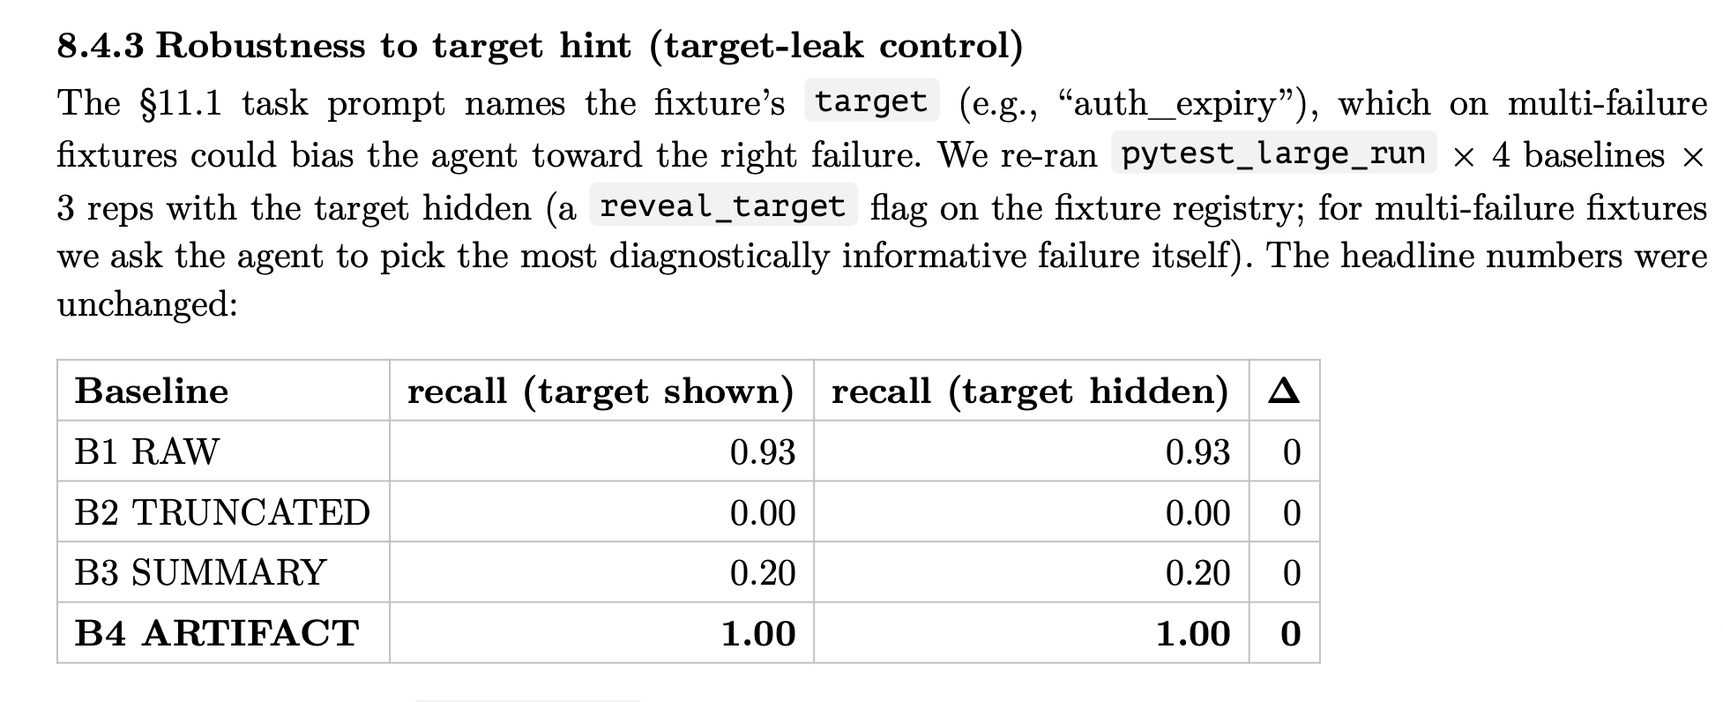
Slide 10：experiment 1
說明四種case的意思

Slide 15
Slide 11：Future Work
What have we built?
What haven’t we finished? limitations?
工具的實際建置，目前是tool call時直接回傳的fixture logs
每種 artifact_type 有自己的 extractor registry。
模型本身的強弱問題

Slide 16
Demo 系統
Demo 展示說明：User Prompt、Supervisor Agent: LLM/ Harness和Sub Agent: LLM/Harness
Work Flow演示：
LLM一次能呼叫多個tool，由harness負責執行，執行過程中不會中途呼叫
Sub Agent可以視為sup agent的一項delegate工具
LLM 每次output有兩種：
Text: 但不一定會有
Tool use reply: 告訴harness要用什麼工具、指令要給什麼
Error handle: 什麼時候會回傳錯誤，錯誤怎麼處理。

